Slide 1
Comparison of ML classifiers

Slide 2
Compared algorithms
Logistic Regression
Naïve Bayes
Support Vector Machines
KNN
K-Means (2 clusters)

Slide 3
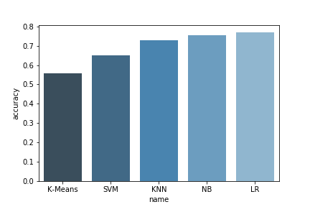
Accuracy
K-Means – 55.7
Support Vector Machines – 65.1
KNN – 72.6
Naïve Bayes – 75.5
Logistic Regression – 76.9

Slide 4
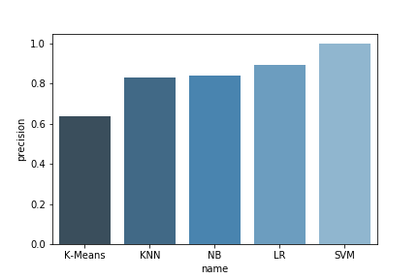
Precision
K-Means – 63.8
KNN - 83
Naïve Bayes – 84
Logistic Regression – 89.2
SVM - 100

Slide 5
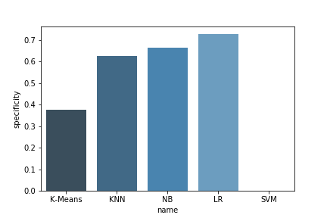
Specificity
K-Means – 37.5
KNN – 62.7
Naïve Bayes – 66.7
Logistic Regression – 72.8
SVM - None

Slide 6
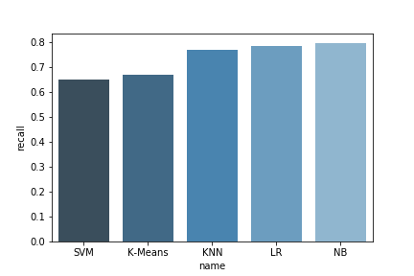
Recall
SVM – 65.1
K-Means – 66.7
KNN – 76.8
Logistic Regression – 78.3
Naïve Bayes – 79.5

Slide 7
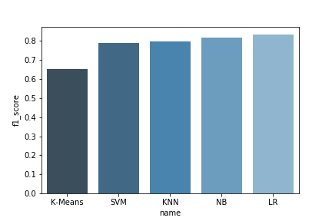
F1 Score
K-Means – 65.2
SVM – 78.8
KNN – 79.8
Naïve Bayes – 81.7
Logistic Regression – 83.4

Slide 8
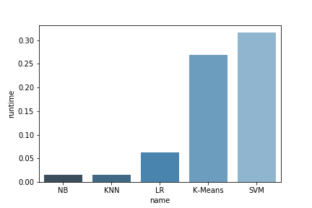
Runtime
Naïve Bayes – 15.5 ms
KNN – 15.6 ms
Logistic Regression – 62.6 ms
K-Means – 269.6 ms
SVM – 316.6 ms

Slide 9
Thank You

